Slide 1


Identifying design elements
Terry Biesboer

Slide 2
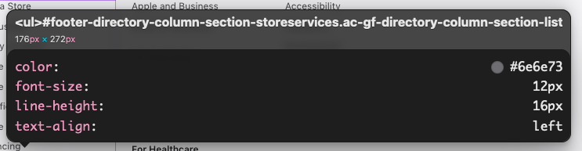
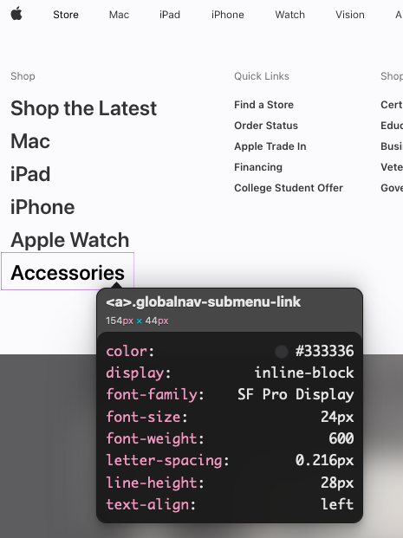
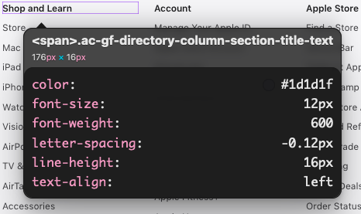
Color – apple.com
Meaning
Balance
Elegance
Mininalism
Neutral
Simple

Slide 3
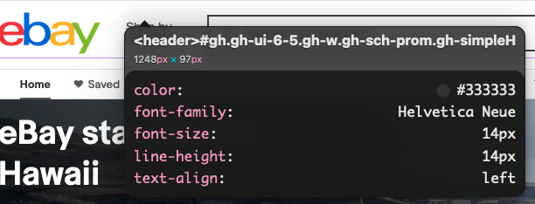
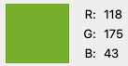
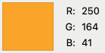
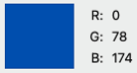
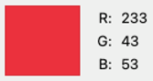
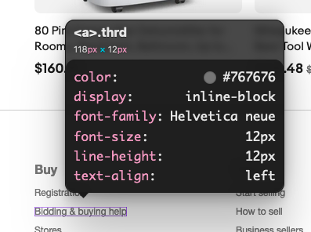
Color – ebay.com
Meanings
Passion
Trust
Confidence
Wealth

Slide 4
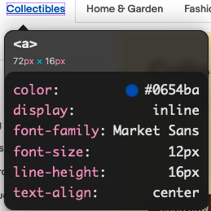
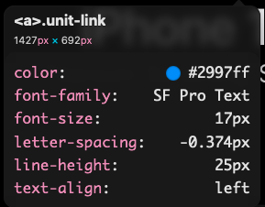
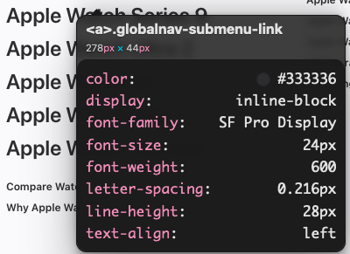
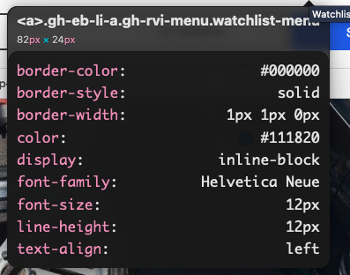
typography
Fonts
Ebay
Market Sans
Helvetica Neue
Apple
SF Pro Text
SF Pro Display

Slide 5
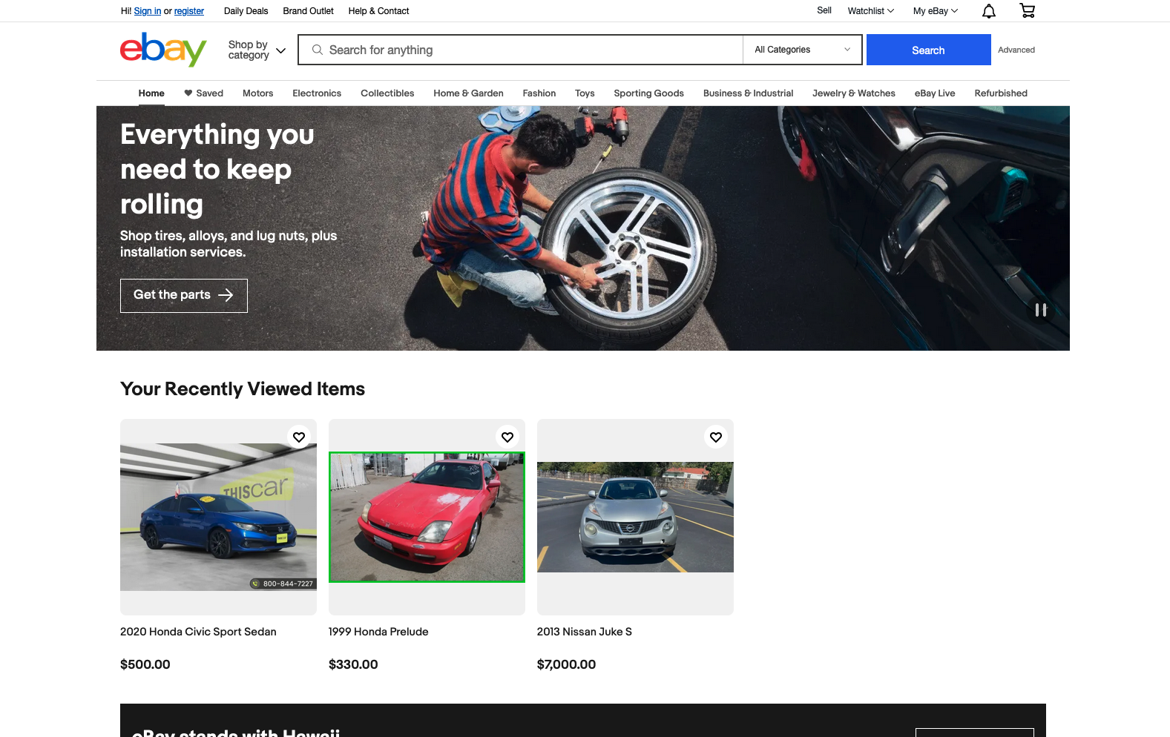
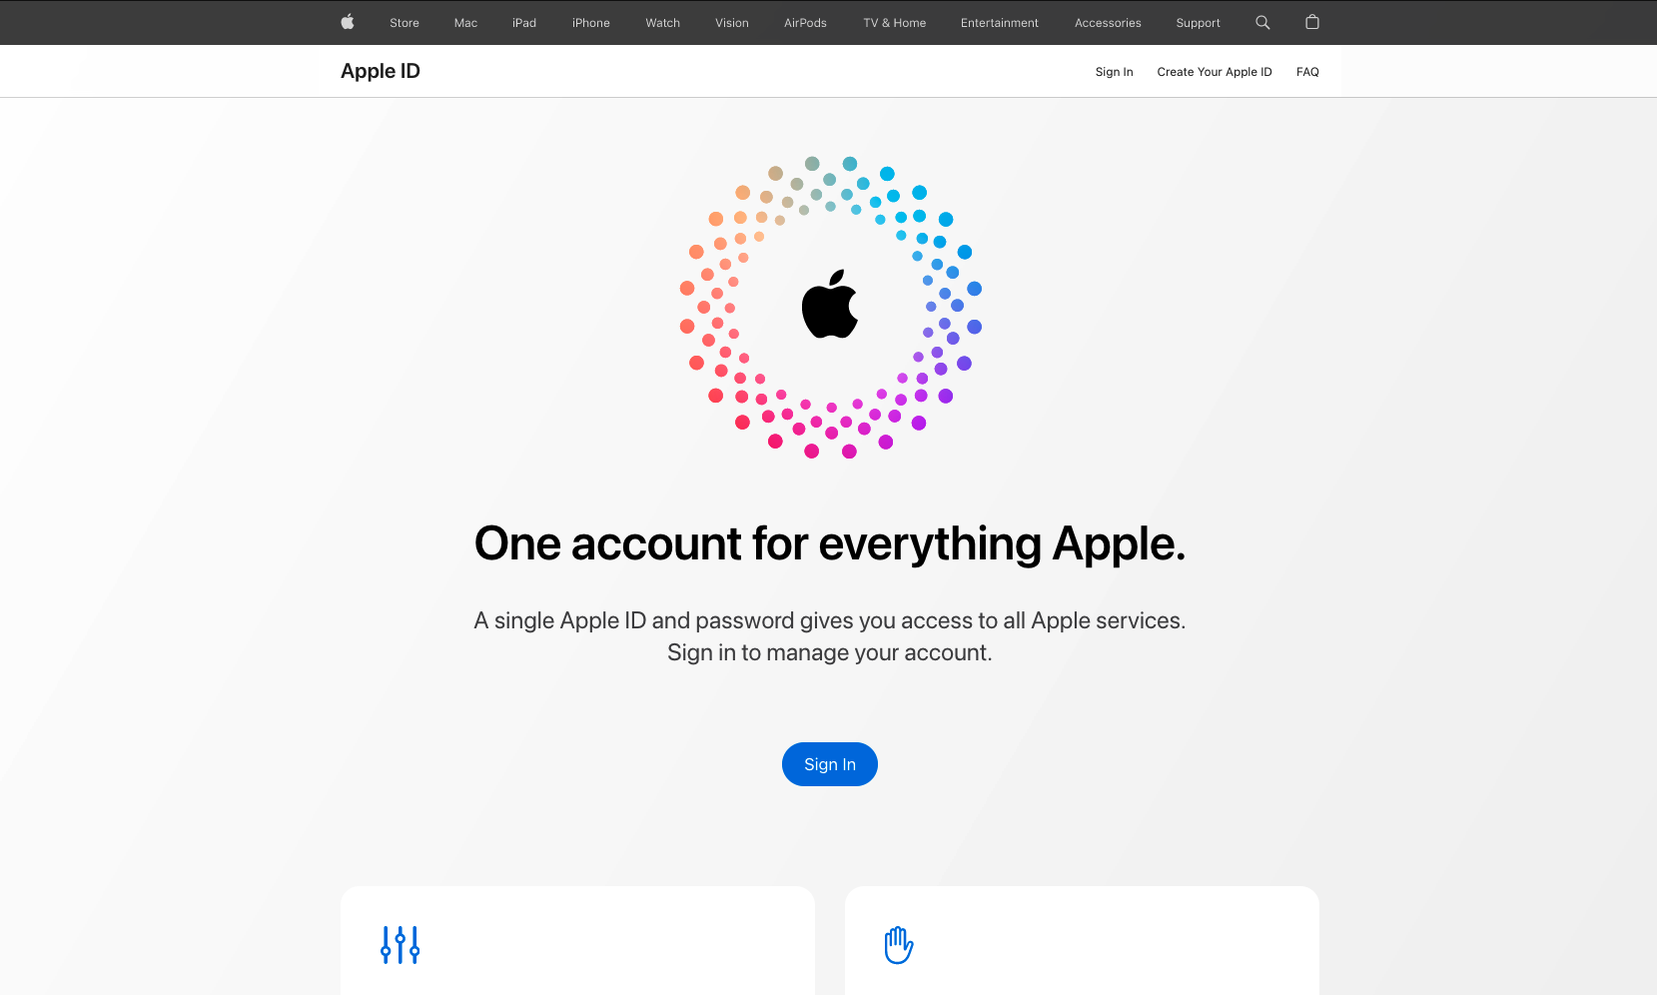
White space
Create contrast
Add emphasis
Draw attention

Slide 6
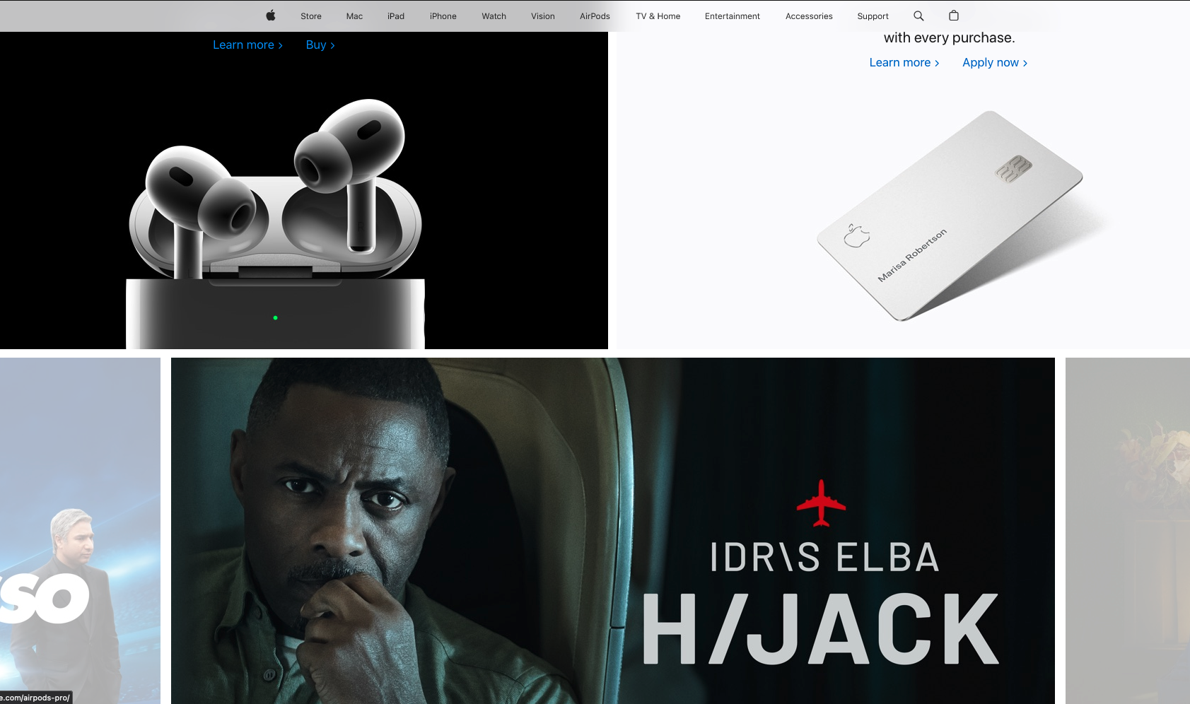
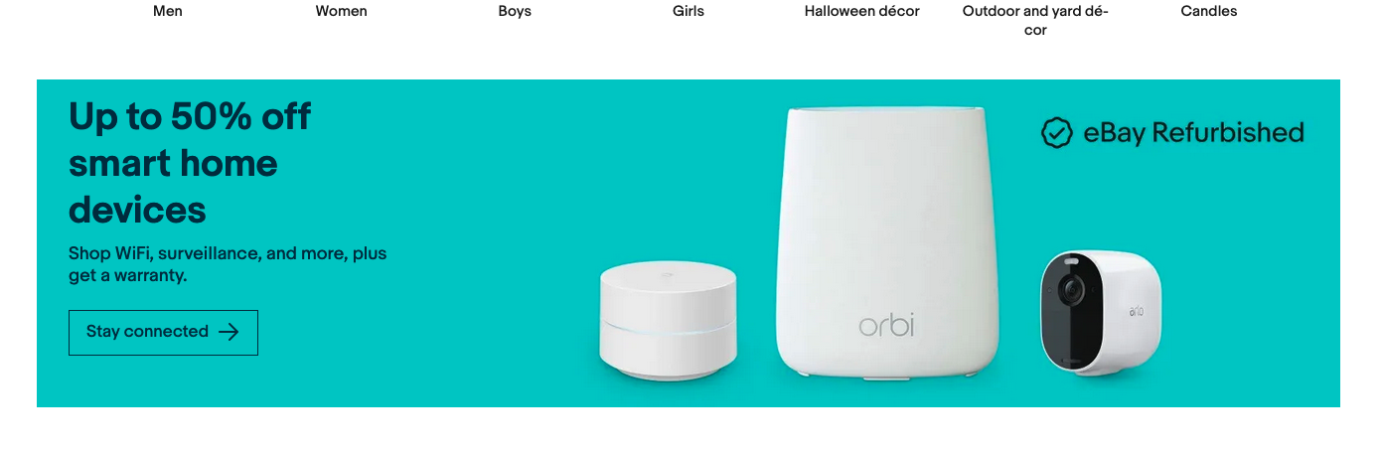
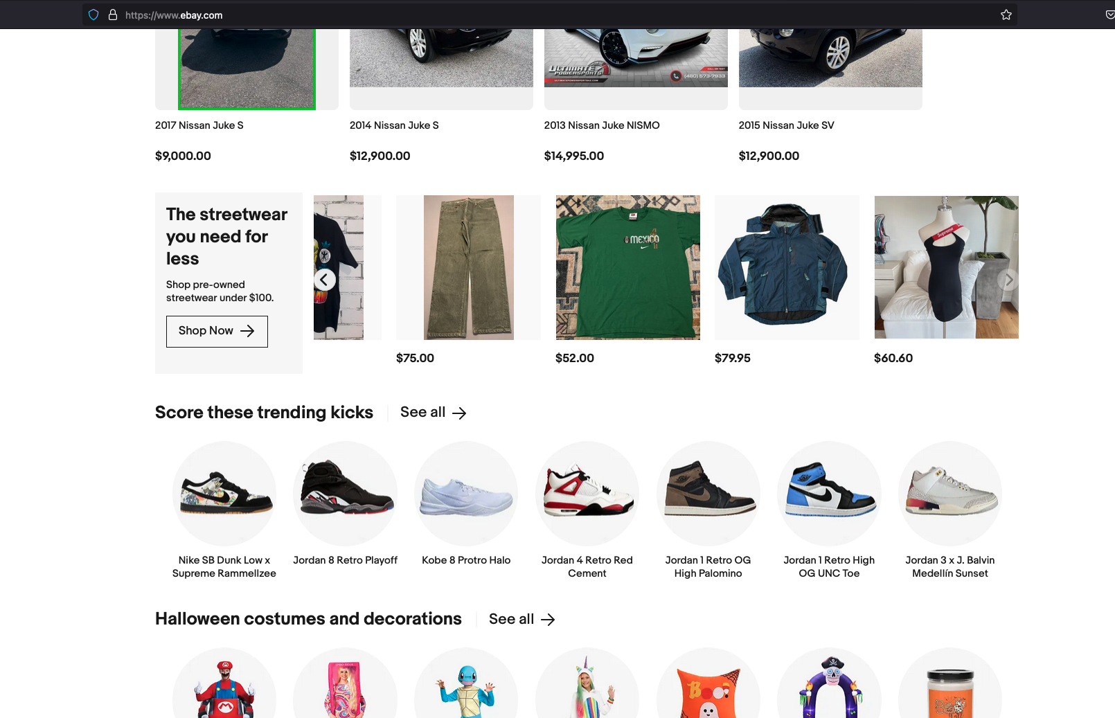
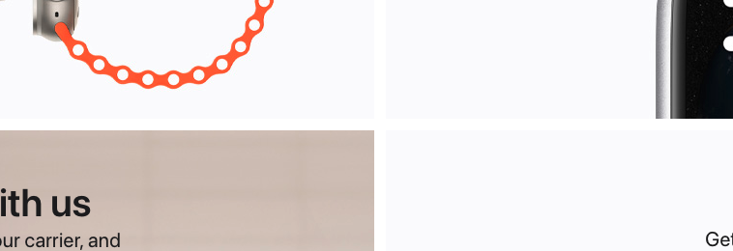
Page layout
Use of both static and dynamic cards
Contrast to show breaks and make items stand out

Slide 7

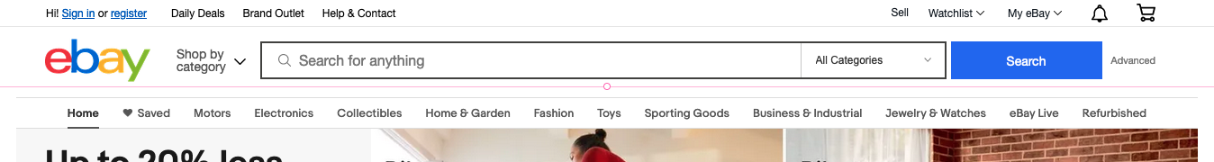

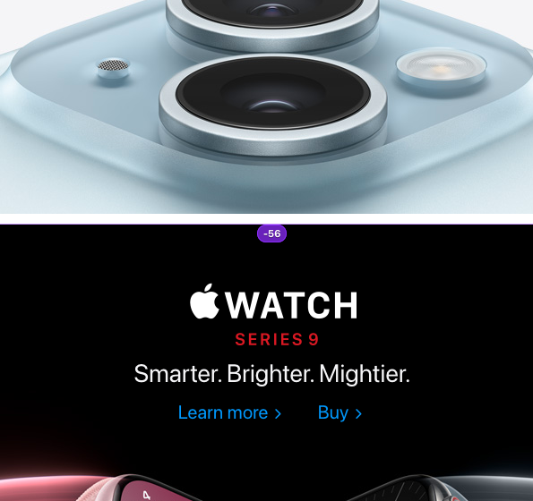
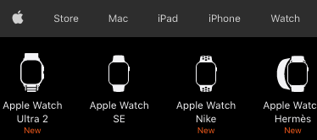
Ui/ux
Nav bars with subsections
are consistent throughout
the site.
Buttons and inputs follow
same design (rounded vs.
squared).
Focus on product
shows balance.
Subsection shows examples
of product in link to item.

Slide 8
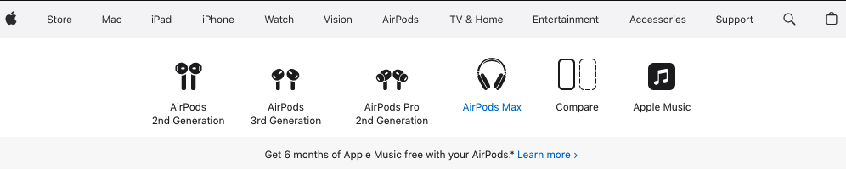
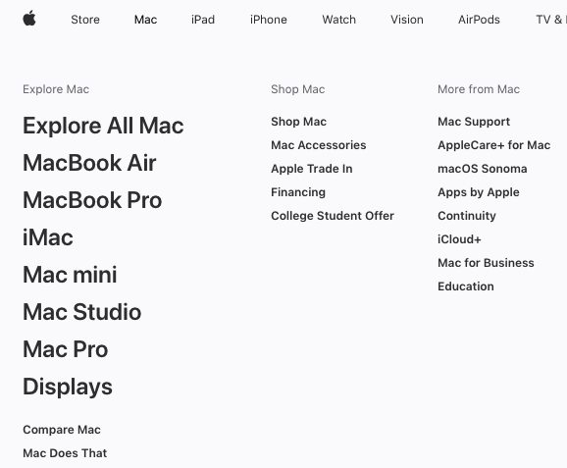
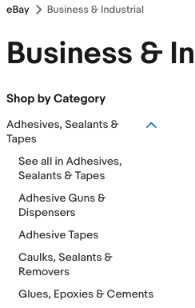
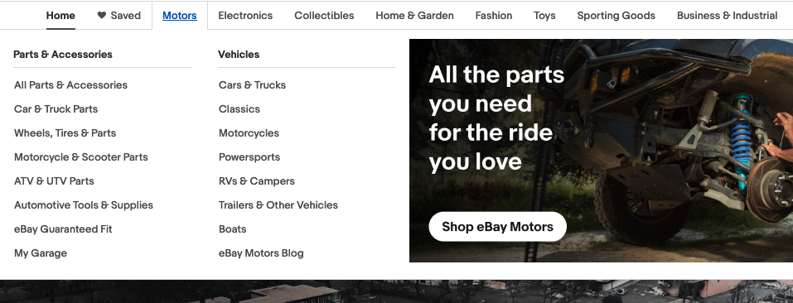
Breadcrumbs
Helps user to know their location
Used to help navigation of site
Divided into sections and
subsections

Slide 9
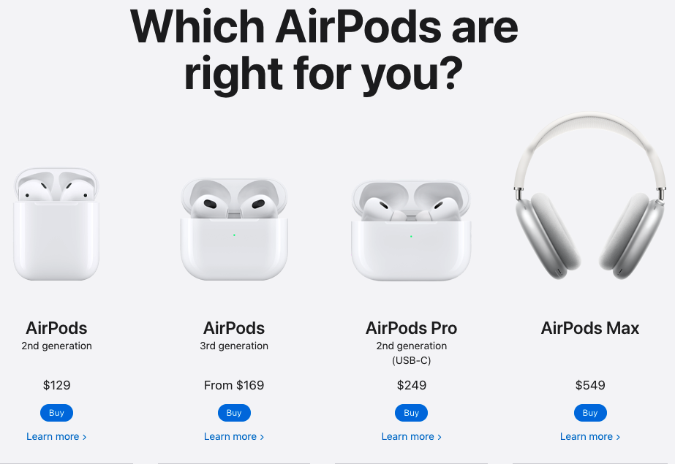

Gallery
Gives user the option to browse without changing pages
Easy navigation using thumbnails
Show multiple items in less space leads to cleaner, more
user-friendly.

Slide 10
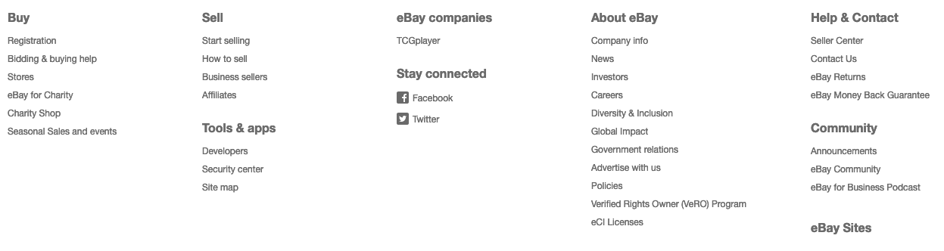
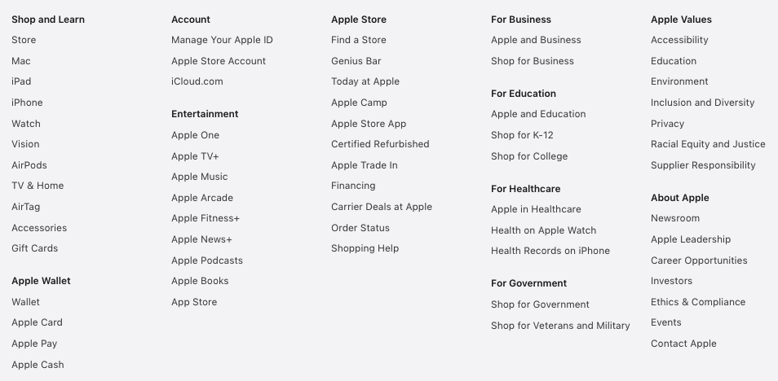
Fat footer
Option to quickly access specific
areas without the need for
navigation.
Used to navigate more frequently
used pages.
Shortcuts to pages on different
hierarchies.

Slide 11
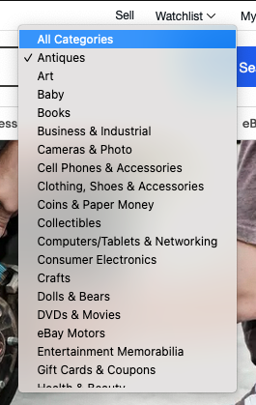
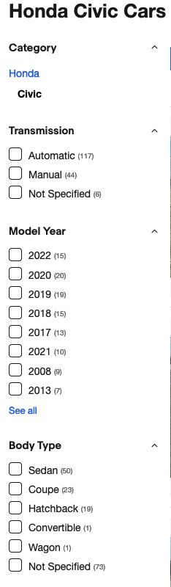
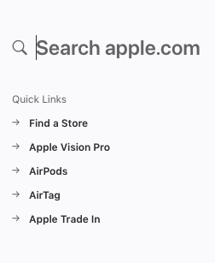
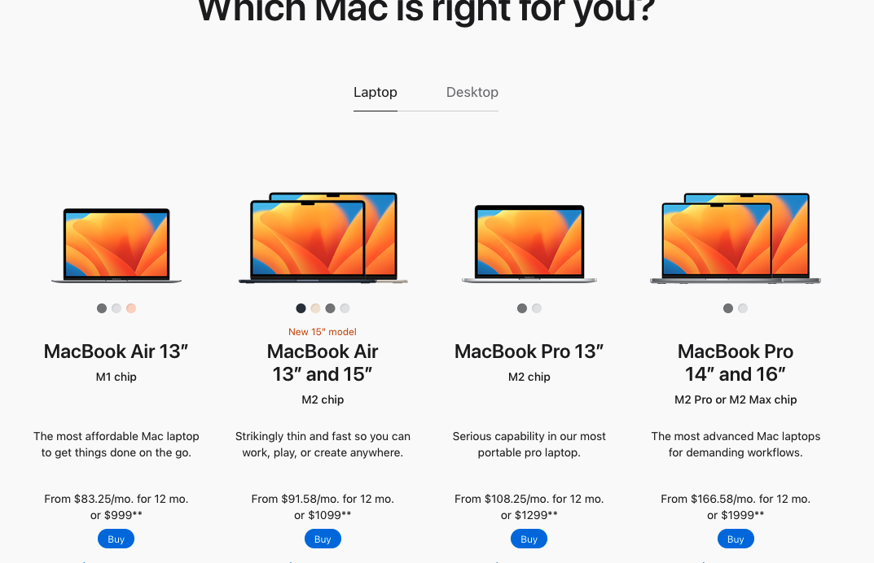
Search filters
Useful when search results need to be narrowed.
Helps refine search results in real time.
Reduces clutter and search time for user.

Slide 12
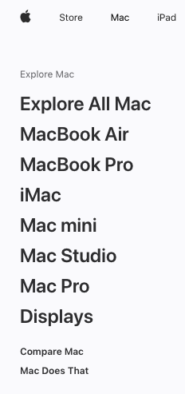
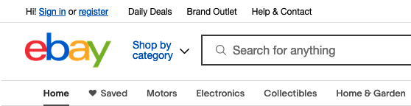
Home link
Helps user navigate from any page back to the main index, reducing the amount of time needed to backout of each page.
Can be text or logo to fit design
May use multiple home pages dependent upon section.

Slide 13
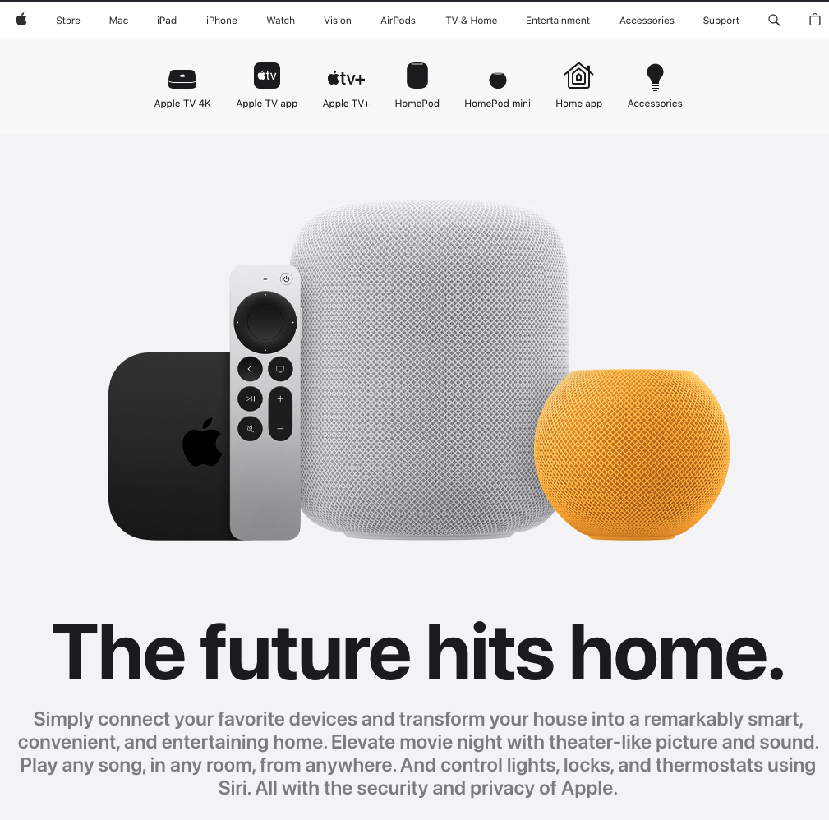

Aesthetic-usability effect
Users often perceive aesthetically pleasing design
more usable.
Creates a more positive response and promotes
the idea of better functionality.

